Slide 1

🦅
🦅
🦅
🦅
🦅
🦅
🦅
🦅
🦅
🦅
🦅
🦅
📔
📓
📖
📖
📓
📔

Slide 2
⌛
☂
Make it easier to buy daily products
☂
Save time
☂
☂
Avoid crowds in big stores
☂
☂
Customer convenience
☂
☂

Slide 3
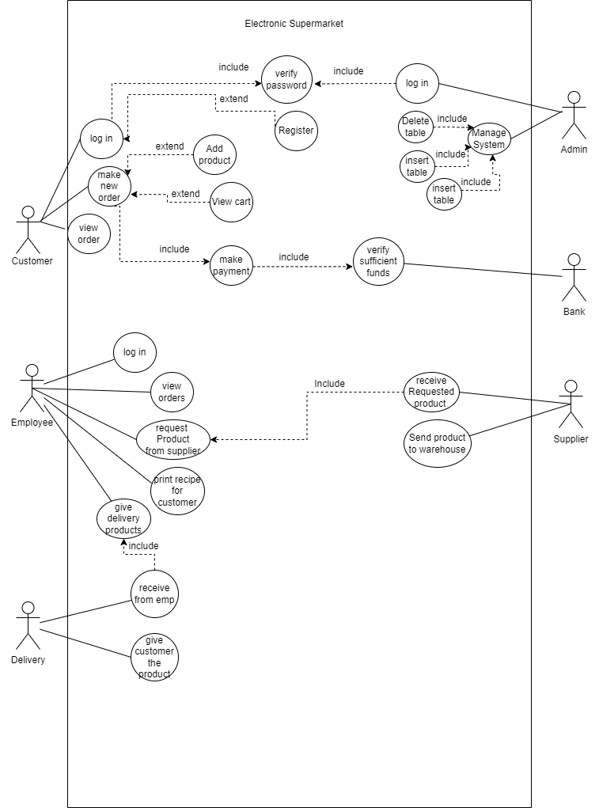
USE CASE

Slide 4
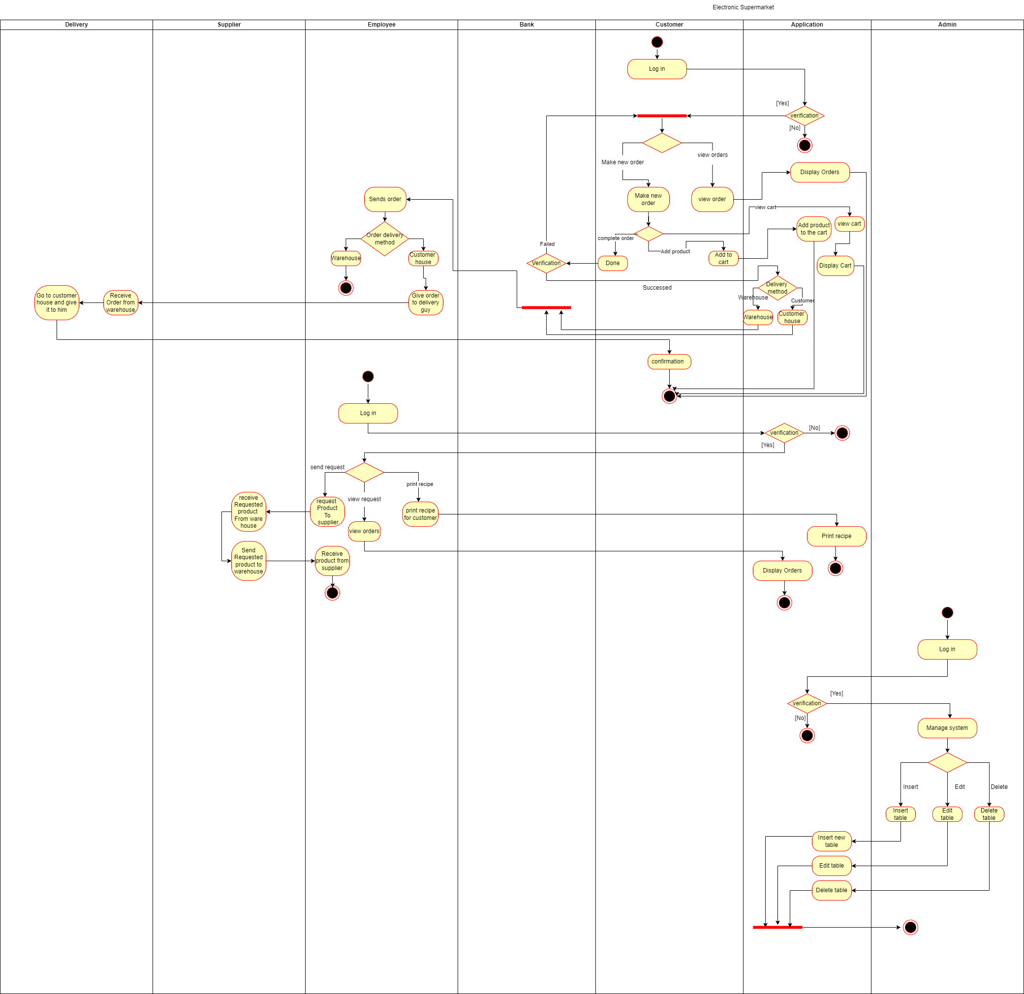
Activity Diagram

Slide 5
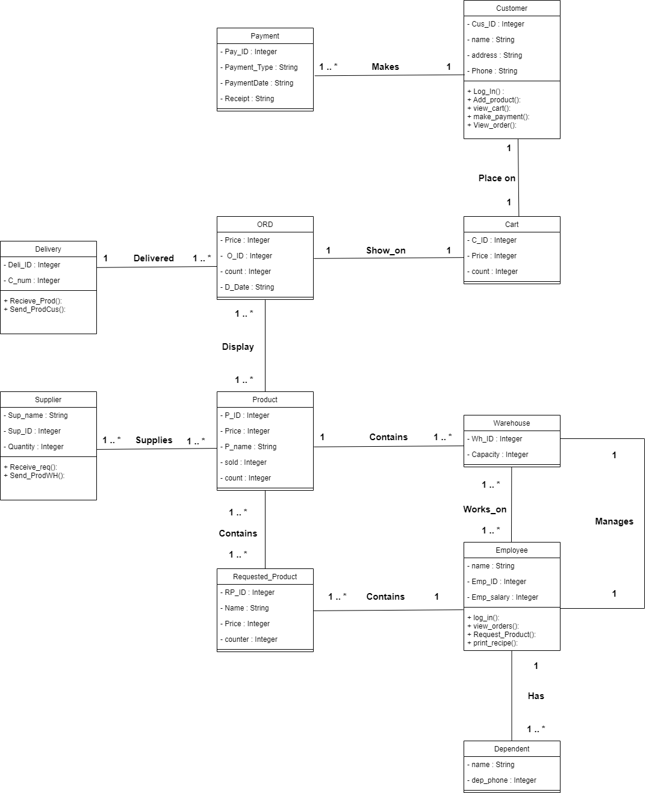

Class diagram

Slide 6
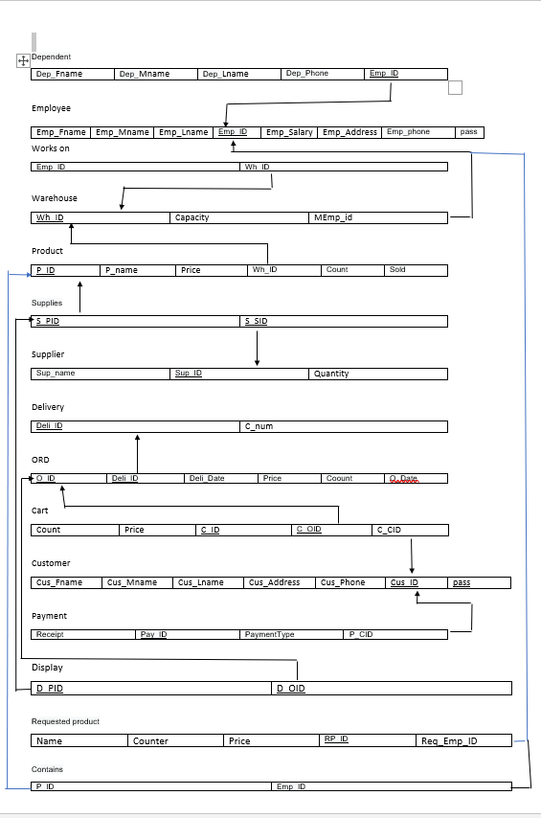

ER Diagram

Slide 7
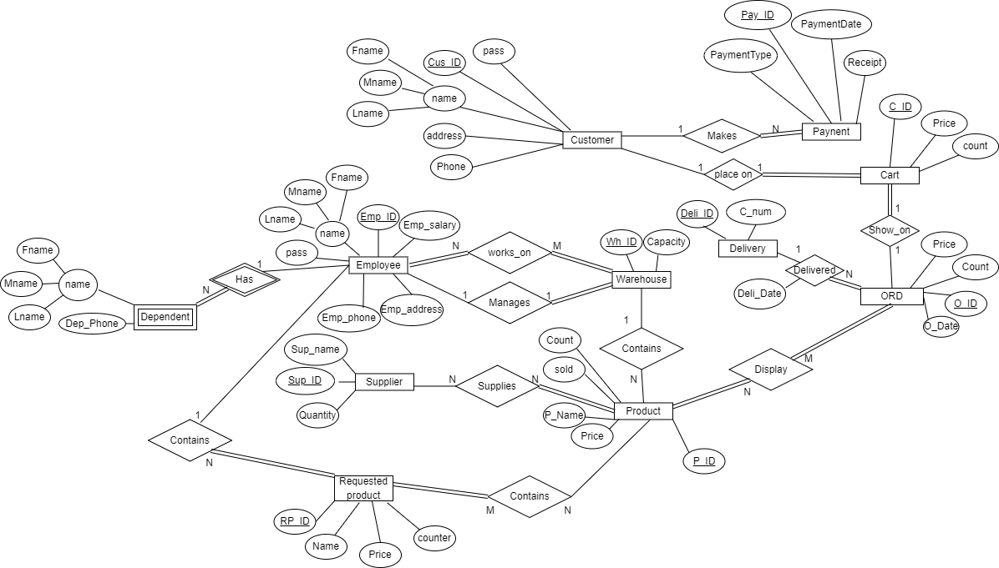

Slide 8
GUI

Slide 9
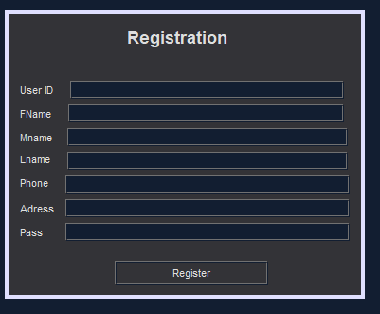
REGISTERATION

Slide 10
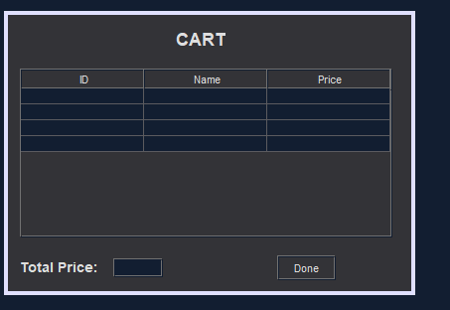
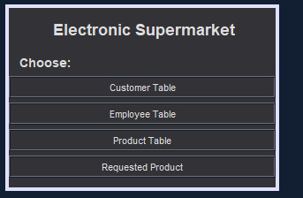
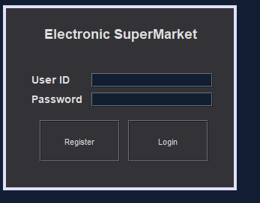
LOG IN

Slide 11
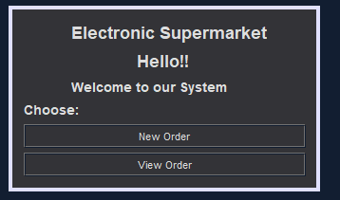
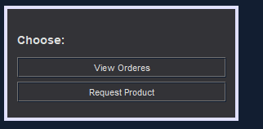
MINU

Slide 12
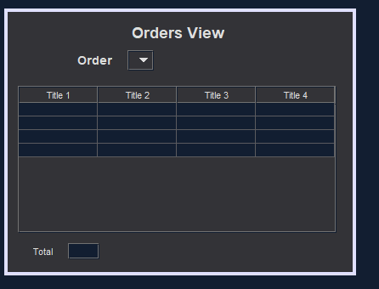
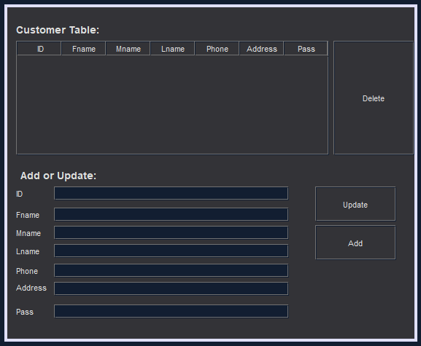
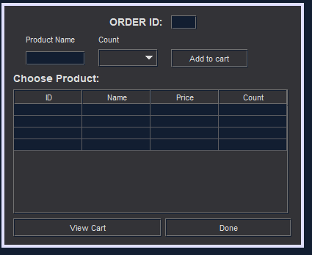
ORDER

Slide 13
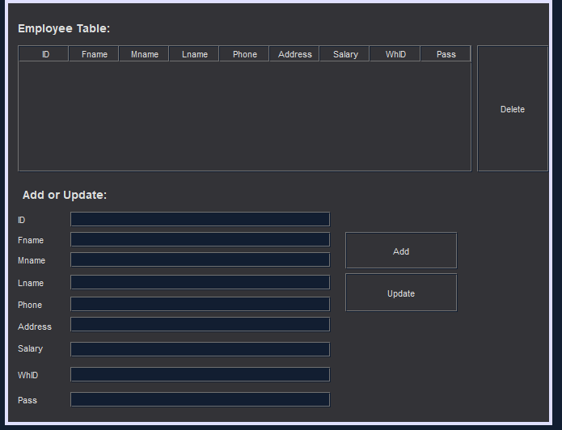
EMP UPDATE

Slide 14
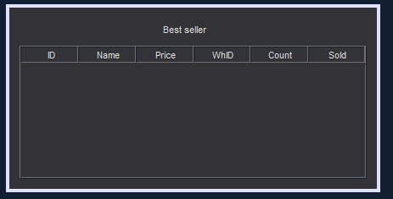
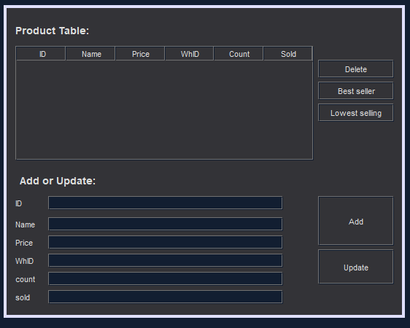
PRODUCY UPDATE

Slide 15
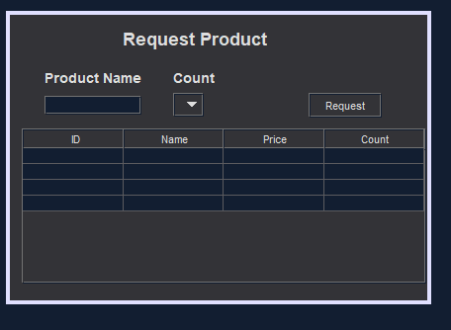
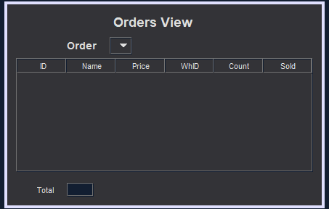
REQUIST PRODUCT

Slide 16
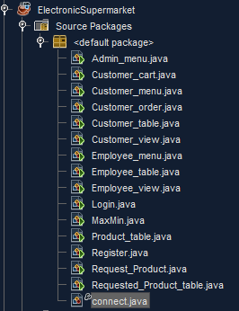
SRC

Slide 17
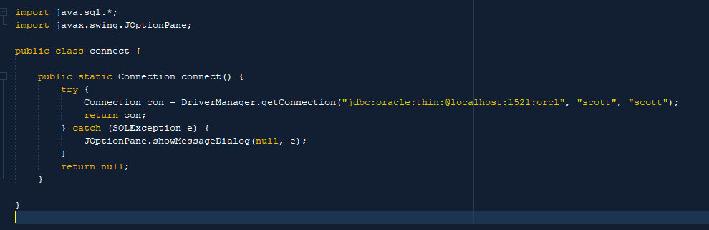
CODE

Slide 18

Thanks !
Do you have any questions?

